Slide 1
INFLUENCER ANALYSIS
Nithya Sharma – 19mia1028
Annugraha S – 19mia1059
Mogalapu Sri Sai Vivek – 19mia1070

Slide 2
ABSTRACT
Influencer marketing on social media has been rapidly getting popular. Nowadays, there are so many people who identify themselves as influencers that it gets harder and harder to identify fake and inauthentic accounts. At the same time, influencer marketing is swiftly moving up the list of priorities for marketing plans. And with good reason too. More than 90% of marketers believe that this kind of marketing is successful. But how can you stay away from dealing with fraudulent accounts? What are some effective ways to employ influencer marketing for your business? You analyze influencers. In this study, we will analyze top influencers using Gephi tool, Power BI and machine learning models like decision tree regressor, random forest regressor, XGB Regressor.

Slide 3
DATASET
The dataset contains information regarding the top influencers .In this dataset, basically there are 10 attributes. It has been ordered on basis of the rank which has been decided on basis of "followers".
rank: Rank of the Influencer on basis of number of followers they have
channel_info: Username of the Instagrammer
influence score: Influence score of the users. It is calculated on basis of mentions, importance and popularity
posts: Number of posts they have made so far
followers: Number of followers of the user
avg_likes: Average likes on instagrammer posts (total likes/ total posts)
60_day_eng_rate: Last 60 days engagement rate of instagrammer as faction of engagements they have done so far
new_post_avg_like: Average likes they have on new posts
total Likes: Total likes the user has got on their posts. (in Billion)
country: Country or region of origin of the user.

Slide 4
METHODOLOGY
In this study we analyzed top influencers data using gephi tool and created some visualizations in Power BI. We also analyzed influencer’s data in python with some of the machine learning models

Slide 5
Algorithms Used
Decision tree Regressor
Random forest regressor
XGB Regressor

Slide 6
VISUALIZATIONS
We have done some visualizations using python which is available in the html file and some using gephi which is available in the word document.

Slide 7
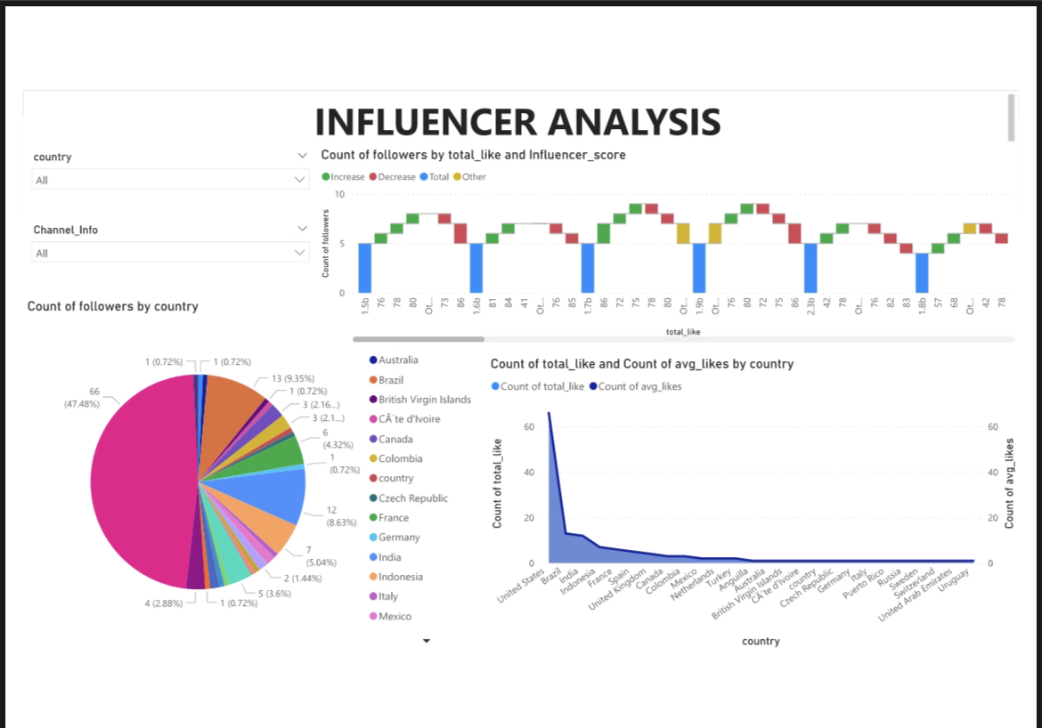
PowerBI

Slide 8
CONCLUSION
The process of arriving at a buying decision has changed dramatically in recent years. Consumers are done with brands that boast about their products and services mindlessly. They now need something more authentic to convince them to go for a product or service. This has increased the value of influencer marketing tenfold. Brand managers can no longer take social media lightly because their sales heavily depend on the same. Brands now have to compete on social media as well to keep their target audience intact. Thus analysis of influencers plays an important role in the current situation.

Slide 9
CONTRIBUTIONS
Nithya Sharma - gephi , PowerBI, report ,ppt
Anugraha S - python models ,report, ppt
Mogalapu Sri Sai Vivek - python models, report, ppt

Slide 10
THANK YOU

